Slide 1
Discussion 8: LLRB’s, Hashing, Heaps
Christine Zhou

Slide 2


Slide 3
Administrivia
Project 2AB released.
ArrayHeapMinPQ due Saturday 3/16
K-D Tree due Saturday 3/23
Lab 8 is out, due Friday 3/15!
Labs will likely be released Sundays now.
You implement a HashMap!
Did you know Challenge Labs are a thing?
Discussion survey: tinyurl.com/cz-disc8-sp19

Slide 4
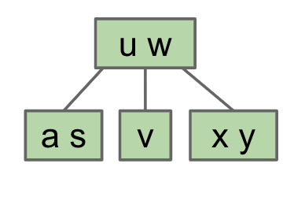
Balanced Search Trees
Bushy was better than spindly trees in terms of runtime
2-3 Trees! (also called 2-4 Trees)
Should still follow the BST property (less on the left, greater on the right)
Each node contains 1-2 elements with 2-3 children nodes
If we want to insert an element, traverse down the tree and put it in the corresponding leaf node (we will always add to leaf nodes)
It’s possible that it will have more than 2 elements
After inserting, split the node by picking the middle element to send up.
This can happen recursively
Try inserting z into our 2-3 Tree!

Slide 5
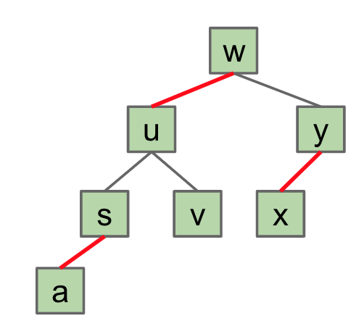
LLRB Tree
Implemented like a BST, but use different colored links to represent 2-3 trees
Black link: connects parent 2-3 tree node to child 2-3 tree node (same as regular tree)
Red link: “glues” child to parent, child and parent are in the same 2-3 tree node
Has one-to-one mapping with 2-3 tree, which means for every LLRB there is a corresponding 2-3 tree!

Slide 6
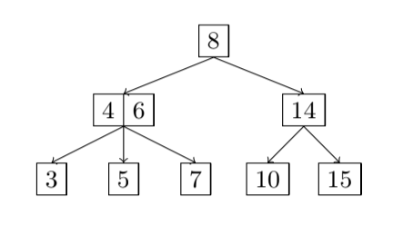
Exercise 1.2
Convert the following tree into a RB tree

Slide 7
Problem 1.1/1.2
8
8
4
6
14
4 6
14
3
5
7
10
15
3
5
7
10
15

Slide 8
Problem 1.1/1.2
8
8
6
14
4 6
14
4
7
10
15
3
5
7
10
15
3
5

Slide 9
Exercise 1.1
Draw what the following 2-3 tree left-leaning red black tree would look like after inserting 18, 38, 12, 13, and 20.
8
6
14
4
7
10
15
3
5

Slide 10
Problem 1.1/1.2 + 18
8
8
6
14
4 6
14
4
7
10
15
3
5
7
10
15
3
5
What colored links should we use to add?

Slide 11
Problem 1.1/1.2 +18
8
8
6
14
4 6
14
4
7
10
15
3
5
7
10
15 18
3
5
18

Slide 12
Problem 1.1/1.2 +18
8
8
6
14
4 6
14
4
7
10
15
3
5
7
10
15 18
3
5
18
Is this left leaning?

Slide 13
Left leaning violation
8
Fix: RotateLeft(15)
In general, RotateLeft(parent of bad red link)
6
14
4
7
10
15
3
5
18

Slide 14
Left leaning violation
8
Fix: RotateLeft(15)
In general, RotateLeft(parent of bad red link)
6
14
4
7
10
15
3
5
18

Slide 15
Left leaning violation
8
rotateLeft(NODE): Let x be the right child of NODE. Make NODE the new left child of x.
6
14
4
7
10
15
3
5
18

Slide 16
Left leaning violation
8
rotateLeft(NODE): Let x be the right child of NODE. Make NODE the new left child of x.
6
14
4
7
10
15
3
5
18

Slide 17
Left leaning violation
8
rotateLeft(NODE): Let x be the right child of NODE. Make NODE the new left child of x.
6
14
4
7
10
3
5
18
15

Slide 18
Left leaning violation
8
rotateLeft(NODE): Let x be the right child of NODE. Make NODE the new left child of x.
6
14
4
7
10
3
5
18
15

Slide 19
Left leaning violation
8
rotateLeft(NODE): Let x be the right child of NODE. Make NODE the new left child of x.
6
14
4
7
10
3
5
18
15

Slide 20
Left leaning violation
8
rotateLeft(NODE): Let x be the right child of NODE. Make NODE the new left child of x.
6
14
4
7
10
18
3
5
15

Slide 21
Problem 1.1/1.2 +18
8
8
6
14
6
14
4
7
10
18
4
7
10
15
3
5
15
3
5
18
New
Old

Slide 22
Problem 1.1/1.2 +18
8
8
6
14
4 6
14
4
7
10
18
3
5
7
10
15 18
3
5
15
Let’s add 38. Where should it go?

Slide 23
Problem 1.1/1.2 +38
8
8
6
14
4 6
14
4
7
10
18
3
5
7
10
15 18 38
3
5
15
38

Slide 24
Problem 1.1/1.2 +38
2. If there are any nodes with two red children, we have a Temporary 4 Node.
Color flip the node to emulate the split operation.
8
8
6
14
4 6
14
4
7
10
18
3
5
7
10
15 18 38
3
5
15
38

Slide 25
Problem 1.1/1.2 +38
8
8
6
14
4 6
14 18
4
7
10
18
3
5
7
10
15
38
3
5
15
38

Slide 26
Problem 1.1/1.2 +38
8
8
6
14
4 6
14 18
4
7
10
18
3
5
7
10
15
38
3
5
15
38
Are we done?

Slide 27
Problem 1.1/1.2 +38
8
8
6
14
4 6
14 18
4
7
10
18
3
5
7
10
15
38
3
5
15
38
Beware of cascades

Slide 28
Problem 1.1/1.2 +38
rotateLeft(NODE): Let x be the right child of NODE. Make NODE the new left child of x.
8
8
6
14
4 6
14 18
4
7
10
18
3
5
7
10
15
38
3
5
15
38

Slide 29
Problem 1.1/1.2 +38
rotateLeft(NODE): Let x be the right child of NODE. Make NODE the new left child of x.
8
8
6
14
4 6
14 18
4
7
10
3
5
7
10
15
38
18
3
5
15
38

Slide 30
Problem 1.1/1.2 +38
rotateLeft(NODE): Let x be the right child of NODE. Make NODE the new left child of x.
8
8
6
4 6
14 18
4
7
3
5
7
10
15
38
18
3
5
14
15
38
10

Slide 31
Problem 1.1/1.2 +38
rotateLeft(NODE): Let x be the right child of NODE. Make NODE the new left child of x.
8
8
6
4 6
14 18
4
7
3
5
7
10
15
38
18
3
5
14
15
38
10

Slide 32
Problem 1.1/1.2 +38
rotateLeft(NODE): Let x be the right child of NODE. Make NODE the new left child of x.
8
8
6
4 6
14 18
4
7
3
5
7
10
15
38
18
3
5
14
15
38
10

Slide 33
Problem 1.1/1.2 +38
rotateLeft(NODE): Let x be the right child of NODE. Make NODE the new left child of x.
8
8
6
4 6
14 18
4
7
3
5
7
10
15
38
18
3
5
14
Extra step: If x already had a left child, make it the right child of NODE.
15
38
10

Slide 34
rotateLeft(NODE): Let x be the right child of NODE. Make NODE the new left child of x.
Extra step: If x already had a left child, make it the right child of NODE.

Slide 35
Problem 1.1/1.2 +38
rotateLeft(NODE): Let x be the right child of NODE. Make NODE the new left child of x.
8
8
6
4 6
14 18
4
7
3
5
7
10
15
38
18
3
5
14
15
38
10

Slide 36
Problem 1.1/1.2 +38
8
8
6
18
4 6
14 18
4
7
14
38
3
5
7
10
15
38
3
5
10
15
Are we done?

Slide 37
Problem 1.1/1.2 +38
8
8
6
18
4 6
14 18
4
7
14
38
3
5
7
10
15
38
3
5
10
15
Are we done?
Yes!

Slide 38
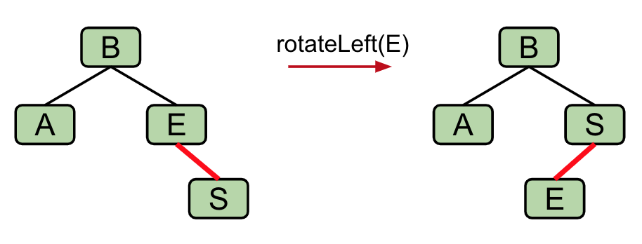
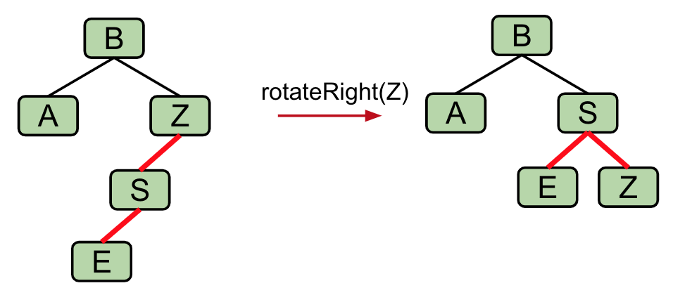
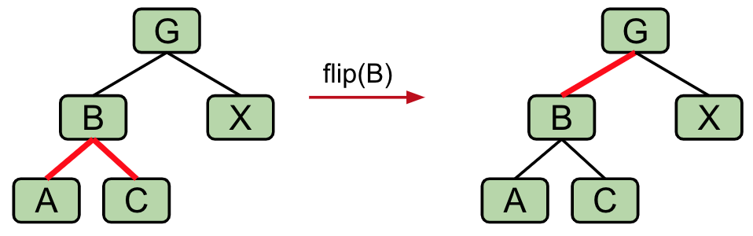
Summary: ADAPTED FROM LECTURE
When inserting: Use a red link.
right leaning “3-node” == Left Leaning Violation.
Rotate left the parent of the right leaning red link.
two consecutive left red links == Incorrect 4 Node Violation.
Rotate right the grandparent of the two consecutive left links
nodes with two red children == Temporary 4 Node.
Color flip the node to emulate the split operation.
Cascading operations: It is possible that a rotation or flip operation will cause an additional violation that needs fixing.

Slide 39
Problem 1.1/1.2 +38
8
8
6
18
4 6
14 18
4
7
14
38
3
5
7
10
15
38
3
5
10
15
Let’s add 12

Slide 40
Problem 1.1/1.2 +12
8
8
6
18
4 6
14 18
4
7
14
38
3
5
7
10 12
15
38
3
5
10
15
What do we do? This is problem #1.
12

Slide 41
Problem 1.1/1.2 +12
8
8
6
18
4 6
14 18
4
7
14
38
3
5
7
10 12
15
38
3
5
12
15
10

Slide 42
Problem 1.1/1.2 +13
8
8
6
18
4 6
14 18
4
7
14
38
3
5
7
10 12 13
15
38
3
5
12
15
What do we do? This is problem #2.
10
13

Slide 43
Problem 1.1/1.2 +13
8
8
6
18
4 6
12 14 18
4
7
14
38
3
5
7
10
15
38
3
5
12
15
13
Are we done?
10
13

Slide 44
Problem 1.1/1.2 +13
8
8
6
18
4 6
12 14 18
4
7
14
38
3
5
7
10
15
38
3
5
12
15
13
No! New problem
10
13

Slide 45
Problem 1.1/1.2 +13
3. If there are two consecutive left links, we have an Incorrect 4 Node Violation.
Rotate right the node with the two left red links. (Here, 18.)
8
6
18
4
7
14
38
3
5
12
15
No! New problem
10
13

Slide 46
Problem 1.1/1.2 +13
3. If there are two consecutive left links, we have an Incorrect 4 Node Violation.
Rotate right the node with the two left red links. (Here, 18.)
8
6
18
rotateRight(NODE): Let x be the left child of NODE. Make NODE the new right child of x.
4
7
14
38
3
5
12
15
No! New problem
10
13

Slide 47
Problem 1.1/1.2 +13
3. If there are two consecutive left links, we have an Incorrect 4 Node Violation.
Rotate right the node with the two left red links. (Here, 18.)
8
6
18
4
7
38
rotateRight(NODE): Let x be the left child of NODE. Make NODE the new right child of x.
14
3
5
12
15
10
13

Slide 48
Problem 1.1/1.2 +13
3. If there are two consecutive left links, we have an Incorrect 4 Node Violation.
Rotate right the node with the two left red links. (Here, 18.)
8
6
18
4
7
38
rotateRight(NODE): Let x be the left child of NODE. Make NODE the new right child of x.
14
3
5
12
15
10
13

Slide 49
Problem 1.1/1.2 +13
3. If there are two consecutive left links, we have an Incorrect 4 Node Violation.
Rotate right the node with the two left red links. (Here, 18.)
8
6
18
4
7
38
rotateRight(NODE): Let x be the left child of NODE. Make NODE the new right child of x.
14
3
5
12
15
10
13

Slide 50
Problem 1.1/1.2 +13
3. If there are two consecutive left links, we have an Incorrect 4 Node Violation.
Rotate right the node with the two left red links. (Here, 18.)
8
6
4
7
rotateRight(NODE): Let x be the left child of NODE. Make NODE the new right child of x.
14
3
5
18
12
15
38
10
13

Slide 51
Problem 1.1/1.2 +13
3. If there are two consecutive left links, we have an Incorrect 4 Node Violation.
Rotate right the node with the two left red links. (Here, 18.)
8
6
4
7
rotateRight(NODE): Let x be the left child of NODE. Make NODE the new right child of x.
If x ALREADY had a right child, make that the LEFT child of NODE.
14
3
5
18
12
15
38
10
13

Slide 52
Problem 1.1/1.2 +13
3. If there are two consecutive left links, we have an Incorrect 4 Node Violation.
Rotate right the node with the two left red links. (Here, 18.)
8
6
4
7
rotateRight(NODE): Let x be the left child of NODE. Make NODE the new right child of x.
If x ALREADY had a right child, make that the LEFT child of NODE.
14
3
5
18
12
15
38
10
13

Slide 53
Problem 1.1/1.2 +13
3. If there are two consecutive left links, we have an Incorrect 4 Node Violation.
Rotate right the node with the two left red links. (Here, 18.)
8
6
14
rotateRight(NODE): Let x be the left child of NODE. Make NODE the new right child of x.
If x ALREADY had a right child, make that the LEFT child of NODE.
4
7
18
12
3
5
15
38
10
13

Slide 54
Problem 1.1/1.2 +13
3. If there are two consecutive left links, we have an Incorrect 4 Node Violation.
Rotate right the node with the two left red links. (Here, 18.)
8
6
14
Are we done?
4
7
18
12
3
5
15
38
10
13

Slide 55
Problem 1.1/1.2 +13
3. If there are two consecutive left links, we have an Incorrect 4 Node Violation.
Rotate right the node with the two left red links. (Here, 18.)
8
6
14
Are we done?
No.
4
7
18
12
3
5
15
38
10
13

Slide 56
Problem 1.1/1.2 +13
3. If there are two consecutive left links, we have an Incorrect 4 Node Violation.
Rotate right the node with the two left red links. (Here, 18.)
8
6
14
Are we done?
No.
Need to fix problem #2 now (AKA color flip.)
4
7
18
12
3
5
15
38
10
13

Slide 57
Problem 1.1/1.2 +13
3. If there are two consecutive left links, we have an Incorrect 4 Node Violation.
Rotate right the node with the two left red links. (Here, 18.)
8
6
14
Are we done NOW?
4
7
18
12
3
5
15
38
10
13

Slide 58
Problem 1.1/1.2 +13
3. If there are two consecutive left links, we have an Incorrect 4 Node Violation.
Rotate right the node with the two left red links. (Here, 18.)
8
6
14
Are we done NOW?
No. Problem #1!
4
7
18
12
3
5
15
38
10
13

Slide 59
Problem 1.1/1.2 +13
3. If there are two consecutive left links, we have an Incorrect 4 Node Violation.
Rotate right the node with the two left red links. (Here, 18.)
8
6
Are we done NOW?
No. Problem #1!
Fake black link for root.
14
4
7
18
12
3
5
15
38
10
13

Slide 60
Problem 1.1/1.2 +13
3. If there are two consecutive left links, we have an Incorrect 4 Node Violation.
Rotate right the node with the two left red links. (Here, 18.)
8
6
Are we done NOW?
No. Problem #1!
Swap colors, as always
14
4
7
18
12
3
5
15
38
10
13

Slide 61
Problem 1.1/1.2 +13
3. If there are two consecutive left links, we have an Incorrect 4 Node Violation.
Rotate right the node with the two left red links. (Here, 18.)
8
14
6
18
12
Are we done NOW?
No. Problem #1!
Swap colors, as always
4
7
15
38
10
13
3
5

Slide 62
Problem 1.1/1.2 +13
3. If there are two consecutive left links, we have an Incorrect 4 Node Violation.
Rotate right the node with the two left red links. (Here, 18.)
8
14
6
18
12
Are we done NOW?
No. Problem #1!
Delete fake link
4
7
15
38
10
13
3
5

Slide 63
Problem 1.1/1.2 +13
3. If there are two consecutive left links, we have an Incorrect 4 Node Violation.
Rotate right the node with the two left red links. (Here, 18.)
8
14
6
18
12
Are we done NOW?
4
7
15
38
10
13
3
5

Slide 64
Problem 1.1/1.2 +13
14
8 14
8
18
6
4 6
12
18
12
15
38
4
7
3
5
7
10
13
15
38
10
13
3
5

Slide 65
Problem 1.1/1.2 +20
14
8 14
8
18
6
4 6
12
18
12
15
38
4
7
3
5
7
10
13
15
20 38
10
13
20
3
5

Slide 66
Summary: ADAPTED FROM LECTURE
When inserting: Use a red link.
If there is a right leaning “3-node”, we have a Left Leaning Violation.
Rotate left the parent of the right leaning red link.
If there are two consecutive left red links, we have an Incorrect 4 Node Violation.
Rotate right the grandparent of the two consecutive left links
If there are any nodes with two red children, we have a Temporary 4 Node.
Color flip the node to emulate the split operation.
One last detail: Cascading operations.
It is possible that a rotation or flip operation will cause an additional violation that needs fixing.

Slide 67
Summary: ADAPTED FROM LECTURE
If there is a right leaning “3-node”, we have a Left Leaning Violation.
Rotate left the parent of the right leaning red link.
RotateLeft(NODE): Let x be the right child of NODE. Make NODE the new left child of x.
Extra step: If x ALREADY had a left child, make that old left child be the right child of NODE.
If there are two consecutive left links, we have an Incorrect 4 Node Violation.
Rotate right the grandparent of the two consecutive left links
RotateRight(NODE): Let x be the left child of NODE. Make NODE the new right child of x.
Extra step: If x ALREADY had a right child, make that old right child be the LEFT child of NODE.

Slide 68
Hashing
Function that produces an integer from a Java object
Properties of a valid hashcode:
Must be an integer
The hashcode for the same object should always be the same
If two objects are “equal”, they have the same hashcode
Properties of a good hashcode:
Distribute elements evenly

Slide 69
Hashtable
Use the hashcode % array.length to index into an array
On collision, one resolution is external chaining
0
1
2
3
4
5

Slide 70
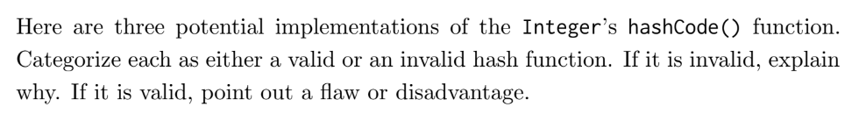
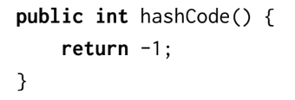
2.1
Properties of a valid hashcode:
Must be an integer
The hashcode for the same object should always be the same
If two objects are “equal”, they have the same hashcode
Properties of a good hashcode:
Distribute elements evenly

Slide 71
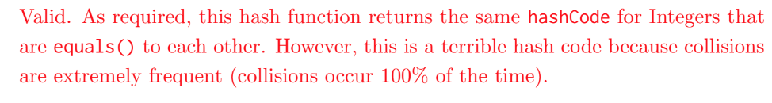

Slide 72
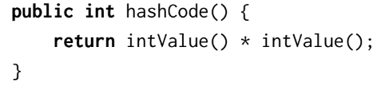
Properties of a valid hashcode:
Must be an integer
The hashcode for the same object should always be the same
If two objects are “equal”, they have the same hashcode
Properties of a good hashcode:
Distribute elements evenly

Slide 73
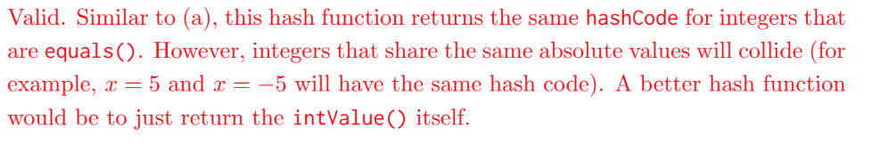

Slide 74
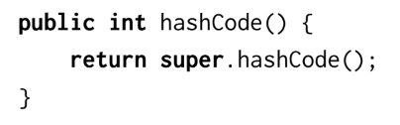
Properties of a valid hashcode:
Must be an integer
The hashcode for the same object should always be the same
If two objects are “equal”, they have the same hashcode
Properties of a good hashcode:
Distribute elements evenly

Slide 75
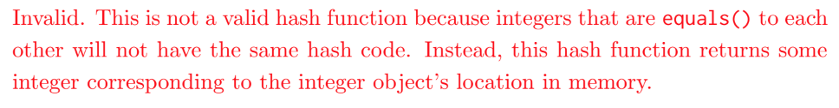

Slide 76
Priority Queues
The priority queue is an abstract data type that contains the following methods:
insert(item, priority): Inserts item into the priority queue with priority value priority.
Poll: Removes and returns the highest priority item in the priority queue.
Peek: Returns the highest priority item.
There are many ways to implement this
LinkedList?
Set?
HashMap?
Binary min heap!

Slide 77
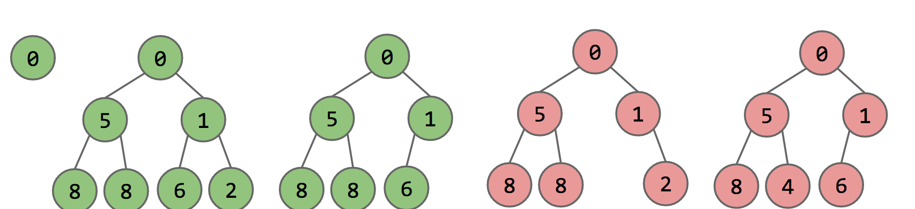
Heaps
Sometimes we want to organize elements in a certain way, always get the minimum
Use a heap!
Complete: missing items only at the bottom level and pushed as far left on the bottom level as possible
(Min/Max) heap property: every node’s value is (less/greater) than or equal to its children’s value
Heap Demo: https://goo.gl/wBKdFQ

Slide 78
Heaps as Arrays
leftChild(k) = k*2
rightChild(k) = k*2 + 1
parent(k) = k/2
1
k
2
e
3
v
4
b
5
g
6
p
7
y
8
a
d
f
j
m
r
x
9
10
11
12
13
14
Key[] keys
-
k
e
v
b
g
p
y
a
d
f
j
m
r
x
0 1 2 3 4
5 6 7 8 9 10 11 12 13 14

Slide 79
Heaps (Runtime)
Operation | Runtime
add(Item x) | Θ(logN)
getSmallest() | Θ(1)
removeSmallest() | Θ(logN)

Slide 80
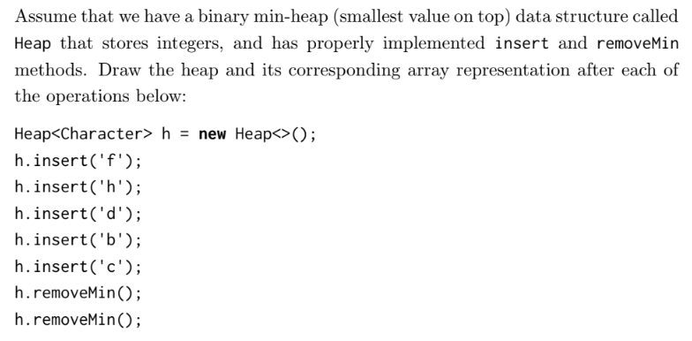
3.1

Slide 81
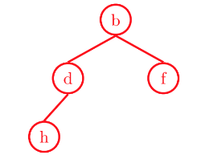

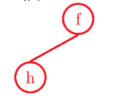
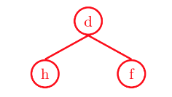
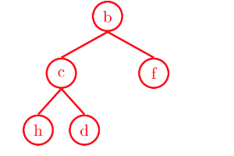
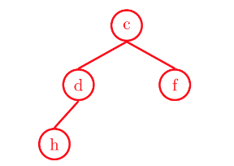
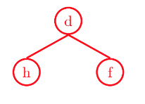

Slide 82
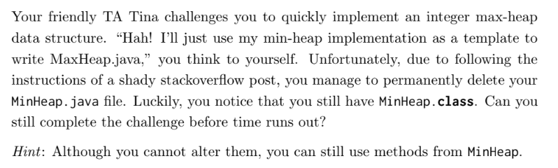
3.2

Slide 83
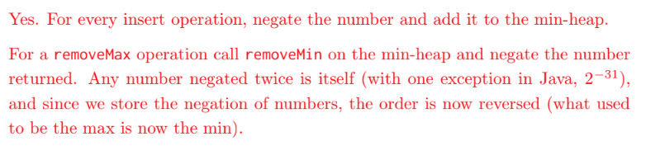

Slide 84
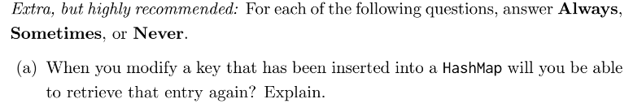
Extra but highly recommend

Slide 85


Slide 88
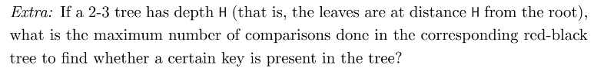
Extra

Slide 89
